Slide 1

CLOthing e-commerce shop project
Džiugas Pečiulevičius ‘n’ Edita Komarova
PI18E

Slide 2
Project idea, goal & scope.
Project idea
Project idea is a custom e-commerce online shop for a client
Project goal
Project goal is to create an e-commerce website that provides all kinds of clothing, quick & easy checkout.
Project scope
User should be able to login/register to the system.
User should be allowed to order anything that is on the website and in-stock.
Browse products.
Should be able to add products to cart and be able to pay for them.
Should be able to see order status.
Should be able to checkout items with a credit card, PayPal or Stripe.

Slide 3
Project Stakeholders & Implementation location and time
Stakeholders
Implementation location and time
Project owner
Customers
Team members
Sellers
Vilnius University of Applied Sciences, 2021
Using virtual tools like MS Teams

Slide 4
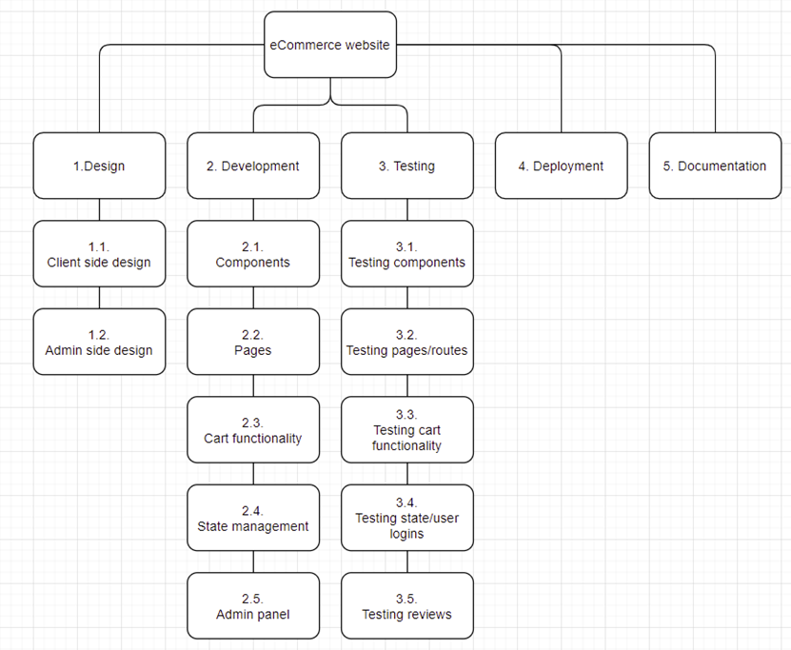
Work Breakdown Structure (WBS)

Slide 5
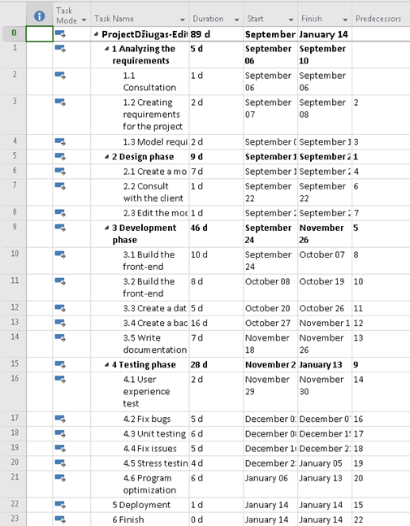
Project tasks, their duration and dependencies

Slide 6
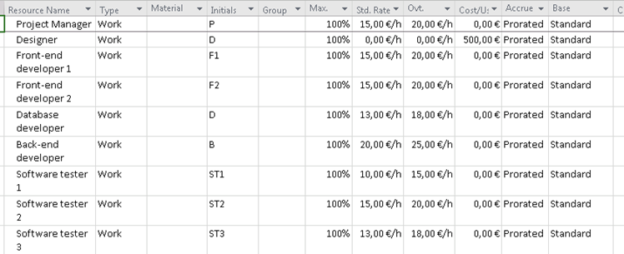
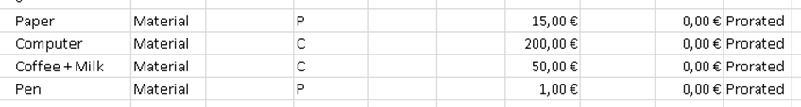
Material and human resources
Material resources and their costs:
Human resources, payment rates & methods:

Slide 7
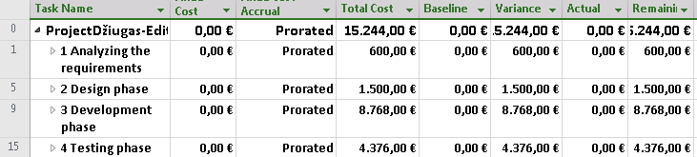
Fixed costs

Slide 8
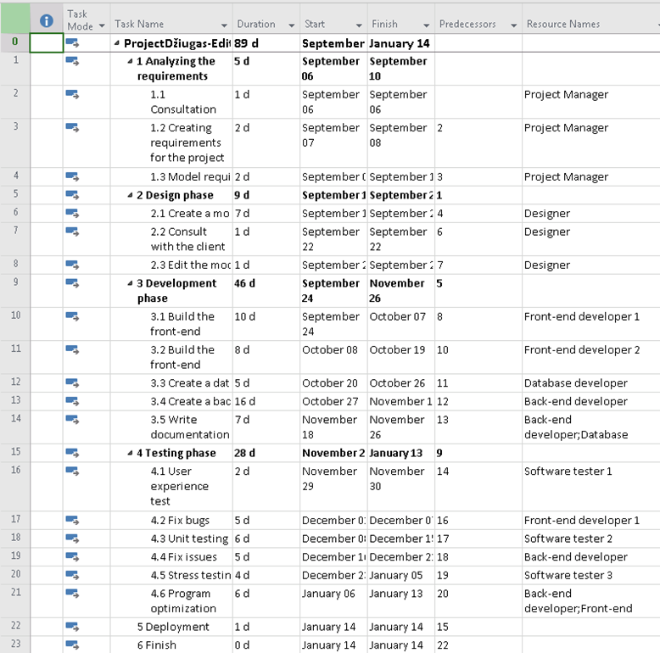
Resources assigned to project tasks

Slide 9
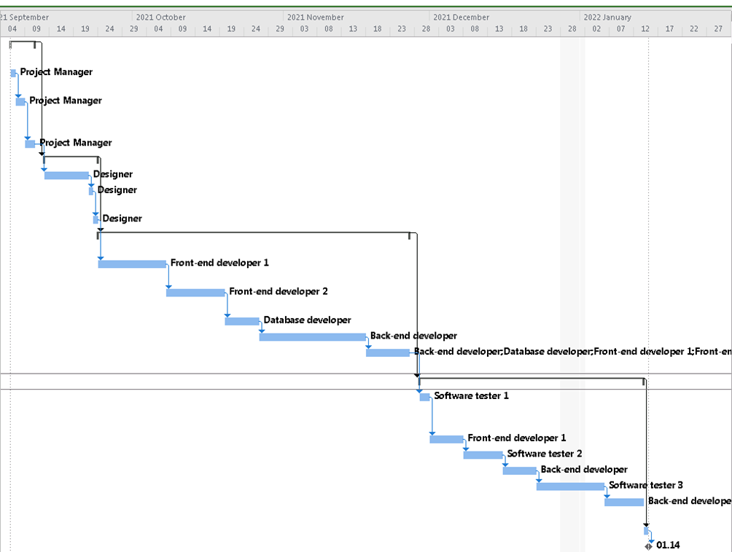
Project schedule

Slide 10
Project budget 15.244€

Slide 11
Project funding resources & scope
Funding resources:
Loan – generally have higher rates of interest and are less flexible as payments need to be made for a pre agreed amount and at a pre-agreed time.
Business Angels – These are private investors who invest directly in a company in exchange for an equity stake and perhaps a place on the board.
Retained profits – Not all profits are distributed to shareholders: the company retains a proportion as reserves.
Funding scope:
Materials – materials such paper and pen will be used during the project’s timeline.
Human resources – project managers, developers, testers will be paid based on the number of hours they spent working on the project.
Contractual workers – Designers who will be given a fixed price of the work they have done.
Licenses – licenses are needed for hosting database and website.

Slide 12
Project risks
Number | Task name | Risk name | Probability (P, 1-10) | Impact (I, 1-10) | Score (P*I)
1. | Cost risks | The project can get too expensive | 6 | 8 | 48
2. | Project purpose and need is not well-defined | This could lead to misunderstandings and that would impact total project duration | 4 | 4 | 16
3. | Project schedule is not clearly defined | This could impact project duration | 6 | 6 | 36
4. | No control over staff | This could lead to decrease in project quality and its duration | 4 | 10 | 40
5. | Unplanned work that has to be done | This would increase the duration of the project | 5 | 10 | 50
6. | Lack of comms, causing lack of clarity and confusion | This could reduce the quality of the project and its duration | 6 | 10 | 60
7. | Project conflicts not resolved on-time | Bugs that are not resolved on time could push back other deadlines that need to be met | 7 | 10 | 70
8. | Theft of materials, intellectual property or equipment | This would not just push back the deadlines itself, but would also need to cover new equipment expenses. | 2 | 10 | 20

Slide 13
Risk reduction measures
To reduce the cost of the project, we should cheaper software.
We should do meetings and talk over every single little bit of things.
Then use proper software, define the project schedule properly that everyone understands.
Pay them higher salaries. Or fire them if they keep misbehaving.
Should have some time allocated between deadlines to finish those unexpected tasks.
Have some more time allocated for these kinds of conflicts.
Always be prepared for these kinds of thefts and have proper insurance.

Slide 14
Quality management
Consultation with the client – there will be consultation with the client to ensure that the client is satisfied with the requirement, design and result.
Meetings – in the meeting project manager will have a chance to inspect the work.
Testing – the project will be tested to ensure that website is going to work very smoothly.

Slide 15
Project communication management
Communications | Frequency | Goal | Audience
Project status report. | Weekly. | Review project status and discuss potential status and delays. | Project team and client.
Team standup. | Daily. | Discuss what each team did yesterday and what they’ll do today. | Project team.
Prototype review. | At milestone. | Show prototype to the client and discuss changes that need to be made. | Project manager, designer and client.
Task progress update. | Daily. | Share daily progress made on tasks. | Project manger, designer, client.

Slide 16
SWOT ANALYSIS
Strengths: Low cost of structure Optimized website More focused on costumer’s satisfaction Strong brand image Online presence | Weaknesses: E-commerce website could be easily replicated Free shipping cost increasing Poor rankings for commercial keywords Preference of customers visiting shop personally
Opportunities: Pandemic Increase of online shoppers Exponential growth Million products to choose from | Threats: Rising competition Cyber security threat Low entry barriers of the industry Government legislation

Slide 17
Thank you!
:)

